Slide 1


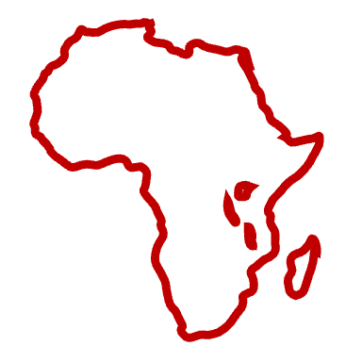
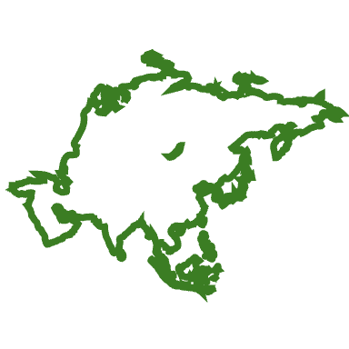
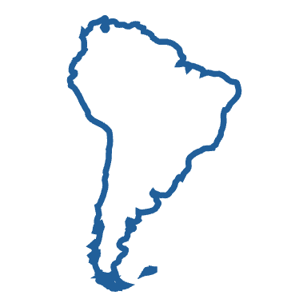

Improving Zika Virus sequence validation, classification and annotation using VADR software
EB Dickinson, Eric P. Nawrocki
Computational Biology Branch, Department of Intramural Research, NLM, NIH
Introduction
Results
VADR (Viral Annotation DefineR) is a software that classifies and annotates viral sequences based on a Reference Sequence (RefSeq) annotation.
VADR can also check sequences for problems and report alerts before submission to GenBank.
Proposing a new RefSeq model for the African sequences
African Genotype
NC_012532
Asian Genotype
NC_035889
model | subgroup | seqs | pass | fail
NC_012532 | ZA-african | 52 | 3 (5.8%) | 49 (94%)
NC_035889 | ZB1-asian | 448 | 378 (84.4%) | 70 (15.6%)
How does VADR work?
VADR builds a reference model along with its features like coding sequences (CDS), gene, mat peptides, and non-coding RNAs.
Table 2. Out of 500 random ZIKV sequences, 94% of African sequences were failing.
ZIKV Feature Annotation
There are 2,575 ZIKV sequences contained within GenBank, and we ran 1,199 non-synthetic and non-patent sequences through our new African model, and the current Asian RefSeq. To find a candidate model, our criteria was that the model was full length and had the representative frameshift.
CDS
gene
Mat_peptides
5’
3’
model | subgroup | seqs | pass | fail
KY989511 | ZA-african | 128 | 120 (93.8%) | 8(6.25%)
NC_035889 | ZB1-asian | 1071 | 1057 (98.96%) | 14 (1.3%)
Structural proteins
Stem loops
Non-structural proteins
Model NC_035889
After using the new model, KY989511, we saw an improvement in the African sequences that pass.
V-annotate.pl
Genotyping ZIKV Sequences Using VADR
Classification
For ZIKV sequences, and there is a gap in accessible taxonomic tools that can accurately genotype ZIKV. Using a curated and genotyped dataset of 759 ZIKV sequences from Seabra et al. 2022, we selected clade-level phylogenetically-informed VADR models that could accurately sort sequences. We think users will benefit from a three-genotype classification: African, Asian, and American.
Assigned based on each sequence’s highest Hidden Markov Model (HMM) score
 | Models
 | AY632535 | MG807646 | KU509998
OK571913.1 | 9571.7 | 11562.4 | 11659.2
MW123921.1 | 9412.9 | 11371.9 | 11487.7
OK054369.1 | 9485.3 | 11459.3 | 11581.9
ZB2 – American
KU509998
Table 1. Each sequence is scored against each model, the highest hmm score means the best likely fit. .
ZA – African
AY632535
ZB1.0 – KX377336
ZB1.1 – MW915411
Classifying, Annotating, And Reporting Alerts For ZIKV
ZB1.2 – MG807646
Figure 2. With the curated models, VADR can accurately genotype African (KY989511), Asian (MG807646), and American (NC_035889) groups.
Zika virus (ZIKV) is a newly emerged mosquito-borne disease associated with neurological symptoms. ZIKV can be transmitted from mother to fetus, causing severe birth defects such as microcephaly, which can lead to abnormal brain development.
We want to demonstrate that VADR is useful for ZIKV with annotation, classification, and reporting problems (alerts).
ZB1-Asian
Combination model
ZB1.1 – MT377504
Figure 1. We selected three total models: ZA-African-AY632535, a combination model of four ZB1–Asian sequences (ZB1.0-KX377336, top branch of ZB1.1-MW915411, bottom branch of ZB1.1- MT377504, and ZB1.2 MG807646), and ZB2 – American, KU509998 from the Seabra dataset.
Summary
We identified a new African reference model , KY989511, that better represents the diversity of the ZA-African genotype.
We found that VADR can accurately sort ZIKV sequences into African, Asian, and American genotypes using curated models.
References
Seabra, Sofia G., Pieter J. K. Libin, Kristof Theys, Anna Zhukova, Barney I. Potter, Hanna Nebenzahl-Guimaraes, Alexander E. Gorbalenya, et al. 2022. “Genome-Wide Diversity of Zika Virus: Exploring Spatio-Temporal Dynamics to Guide a New Nomenclature Proposal.” Virus Evolution 8 (1): veac029.
Acknowledgements
Thank you to Dr. Alvin Crespo-Bellido for generating trees. This research was supported by the Division of Intramural Research (DIR) of the National Library of Medicine (NLM), National Institutes of Health
Notes:
() model labels to explain the different asia labels
() the match between seabra and vadr
() switch
() is it Seabra et al. 2022 or 2021?

